Slide 1


Maciej Lasyk
2014-05-30

Slide 2

Terminal you say?

Slide 3

terminator
guake
iterm2
putty

Slide 4
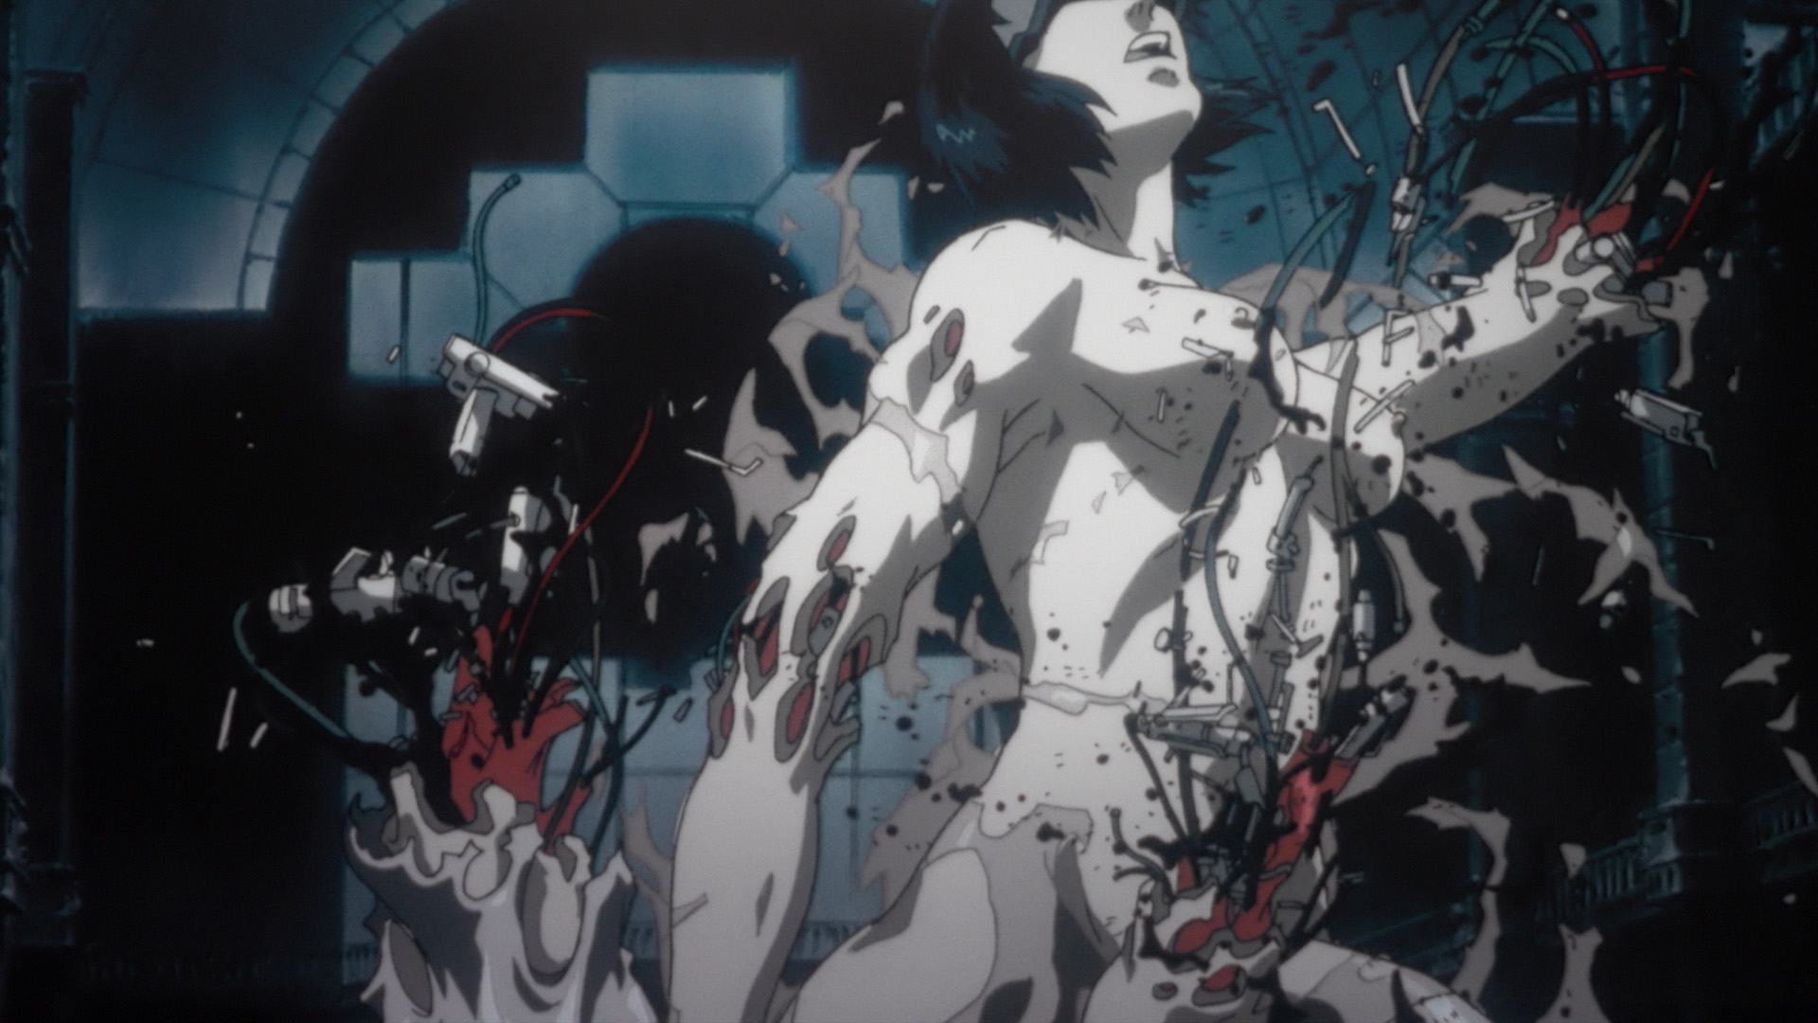
TPP
vs
LibreOffice

Slide 5

Bash vs Zsh

Slide 6

Screen vs Tmux

Slide 7
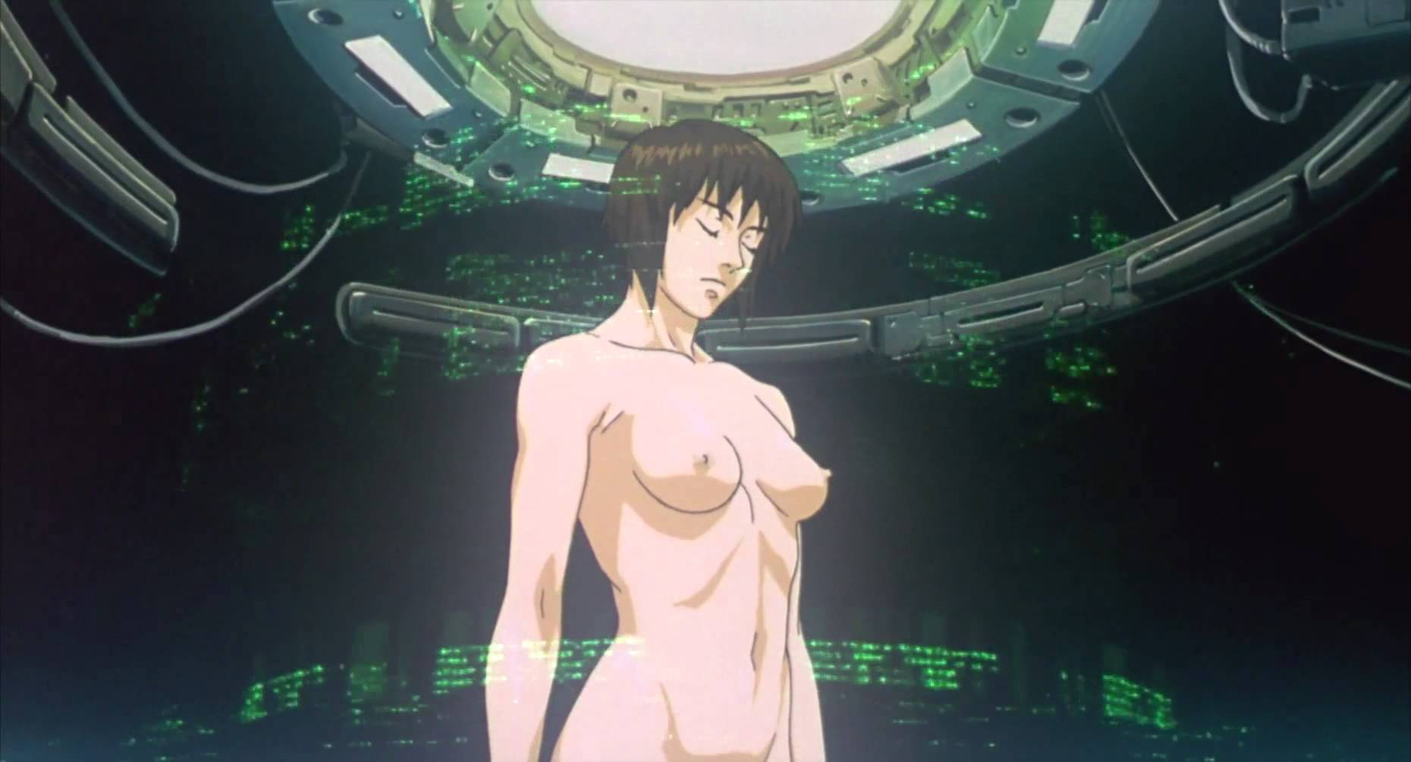
Privacy
OpenVPN
cloaking

Slide 8
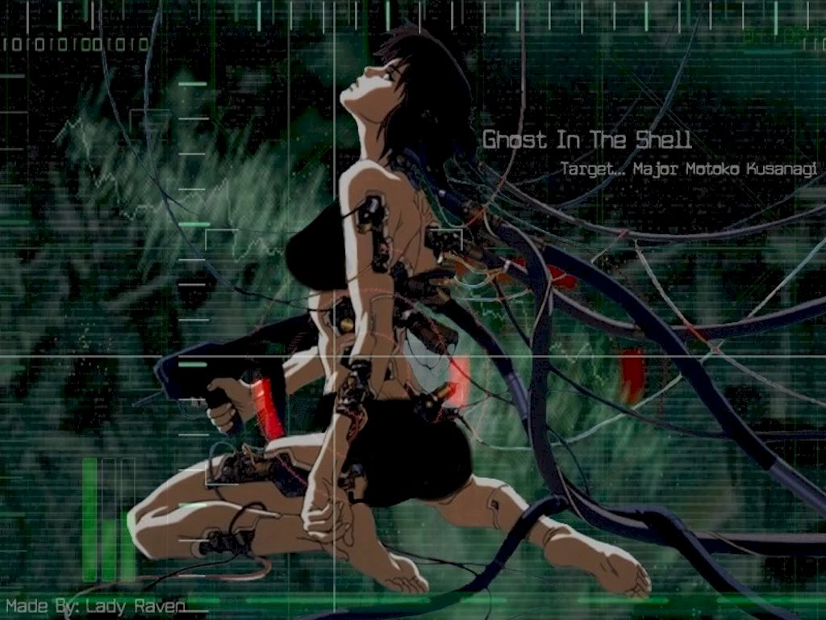
IRC / Irssi

Slide 9

XMPP / finch

Slide 10
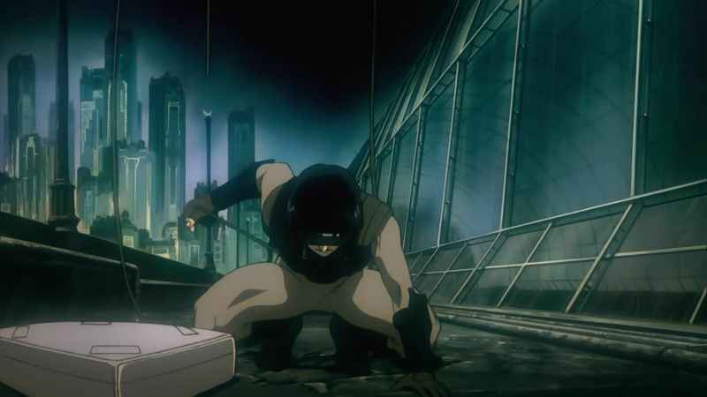
Twitter:
Earthquake

Slide 11

RSS / Newsbeuter

Slide 12
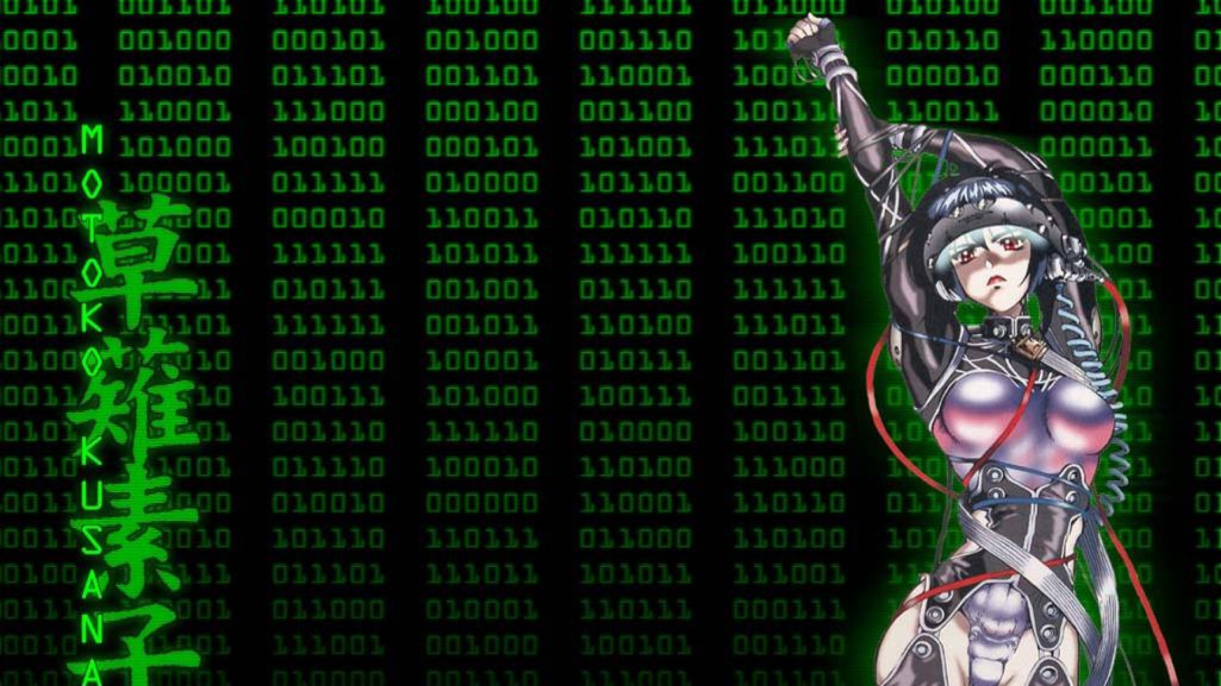
Owncloud
DropBox
Google Drive

Slide 13

VIM

Slide 14

Mutt

Slide 15

GTD / Taskwarrior

Slide 16
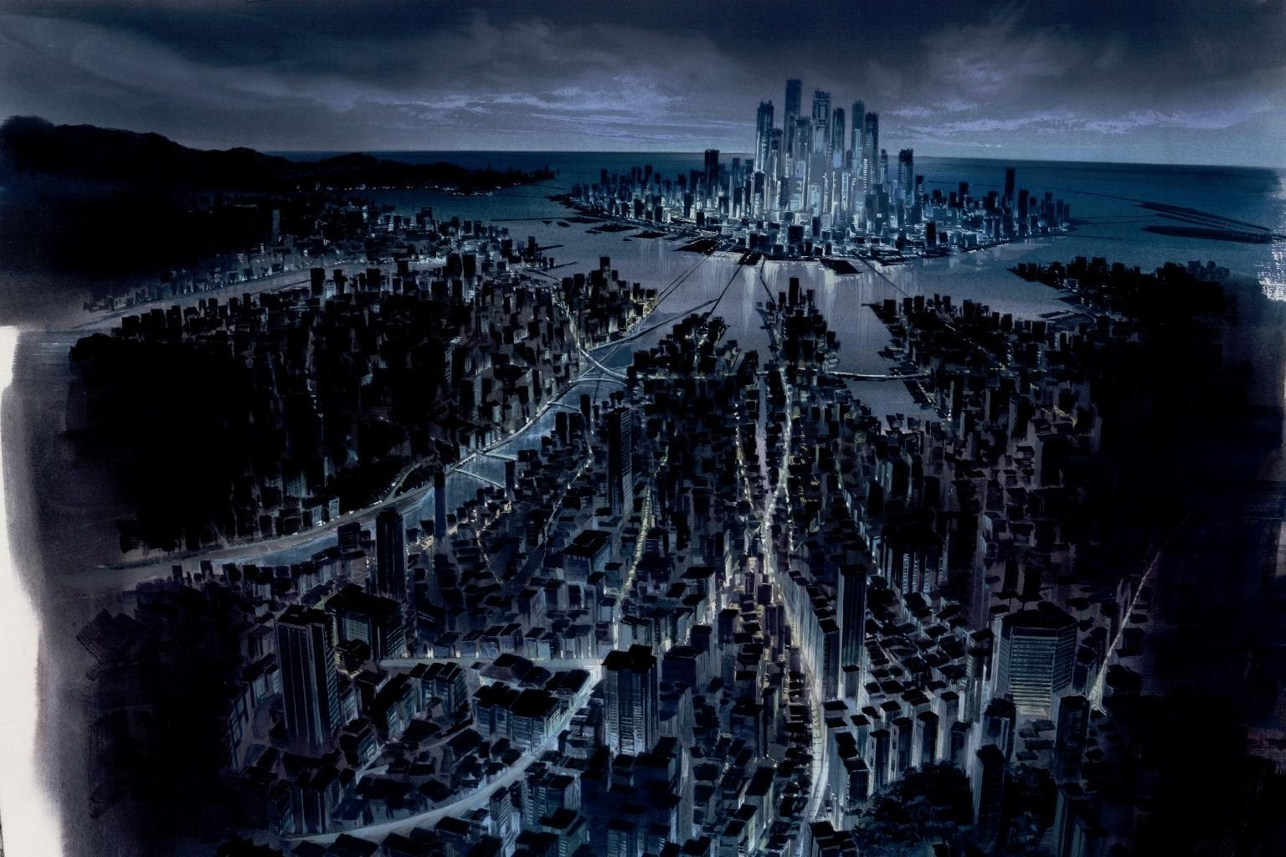
Evernote
Geeknote
Evervim

Slide 17

Google Chrome
keyboard
navigation
quick tabs
vimium

Slide 18

Mobile?

Slide 19

https://github.com/
docent-net/
ghost-in-the-shell

Slide 20

Thanks guys, Q&A?
Maciej Lasyk
@docent-net
maciek@lasyk.info
http://maciek.lasyk.info/sysop

